Slide 1
Combined report ACI Board 2009-2010

Slide 2
We are on board!
The year started with
The ACI conference in Bruges 2009 ….

Slide 3
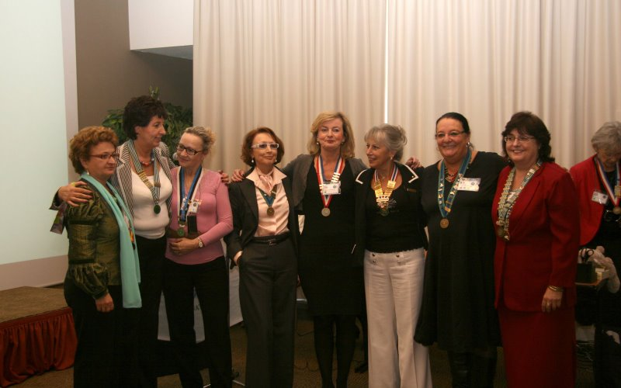
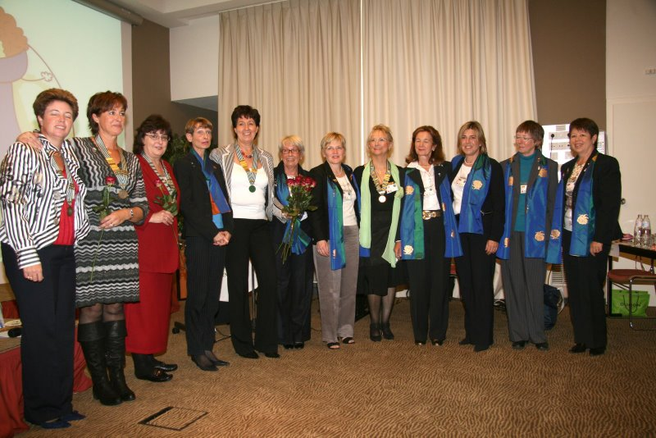
“Together we are strong” : Presidents 08-09
A milestone in Agora’s history : Tangent Germany joins Agora International :
all past-Circlers finally
re-united!

Slide 4
Boardmeeting 1 : 4,5 and 6 october 2009 We worked hard to write :
Guidelines how to charter a first club
Guidelines for Agora Club Godmother countries
How to start Agora in a new country
How to form further Agora Clubs
Guidelines for Tellers at the ACI AGM
Guidelines for the ACI Boardmembers
Application form for ACI conference
Nomination form ACI Officer
What to bring with you at the ACI AGM
List of documents to be sent out and sent to the ACI secretary
ACI yearplanner

Slide 5
And all these forms can be consulted on our website !
www.agoraclubinternational.com

Slide 6
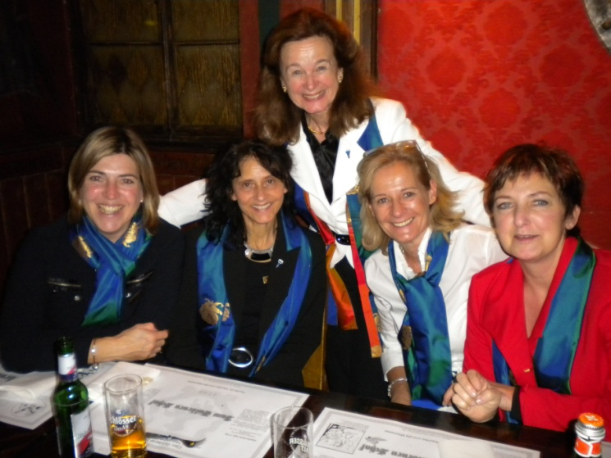
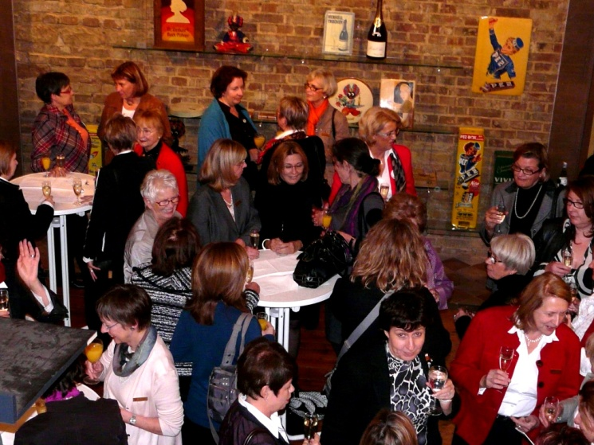
Our Agora Club International is growing….
While our newest member country Agora Tangent Germany is having its half-year Meeting in Heidelberg, on the 14th of november….

Slide 7
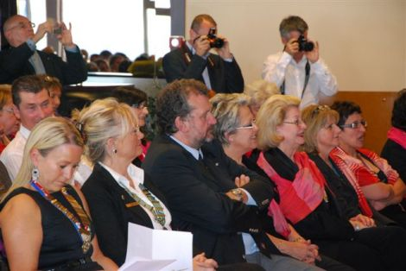
A new local club is chartered in France : AC Hyères
17th of October 2009

Slide 8
New year’s festivities came …and went
So high time to prepare for ….

Slide 9
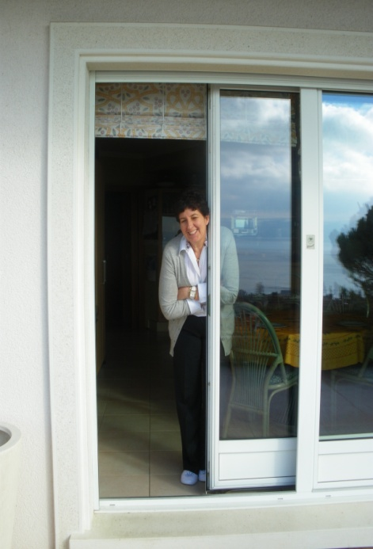
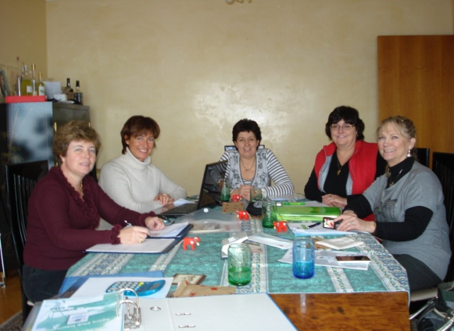
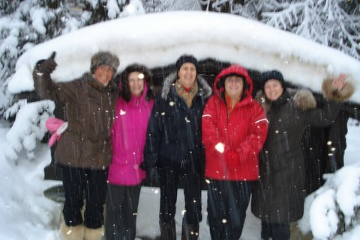
The 3rd Boardmeeting :
Our boardroom at Nicole’s house with view…on Lac Leman
Brrrrrr….
it’s cold!
blablarules, guidelinesbla
blablafinances blabla
websiteblabla
blablaExtension-proposal-conference-chartersblabla
THE SNOW-BOARD !

Slide 10
Spring in the air…
And BABYBOOM IN AGORA !!

Slide 11
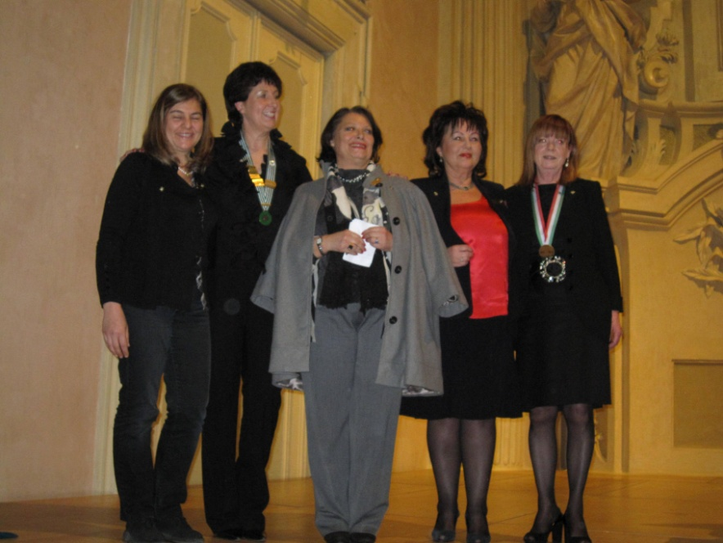
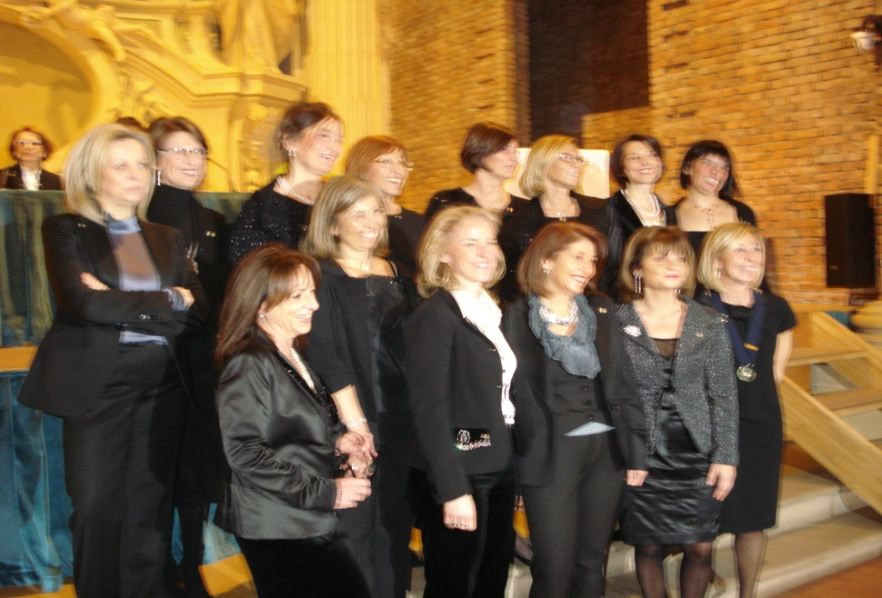
Charter Toulouse (FR) 6-3-2010
And the installation of the national Board of AC Italy ! 13-3-2010
Charter Bologna (It) 13-3-2010

Slide 12
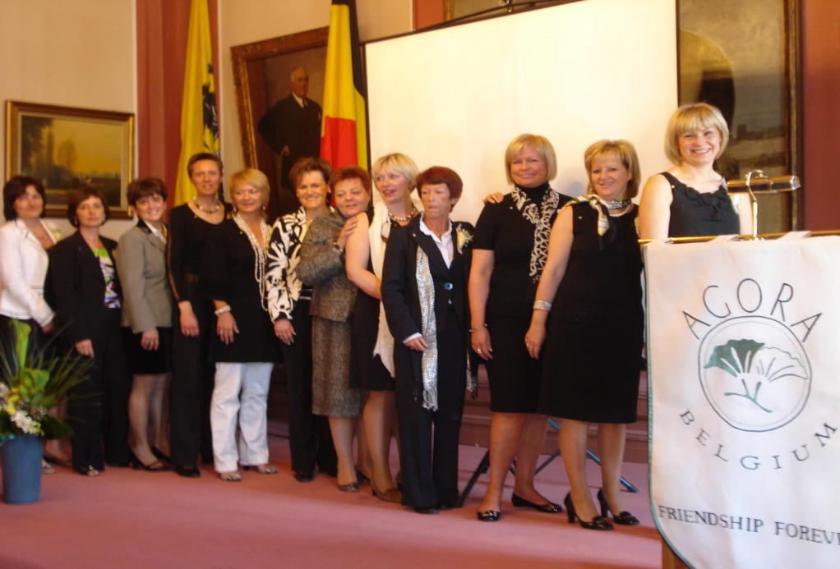
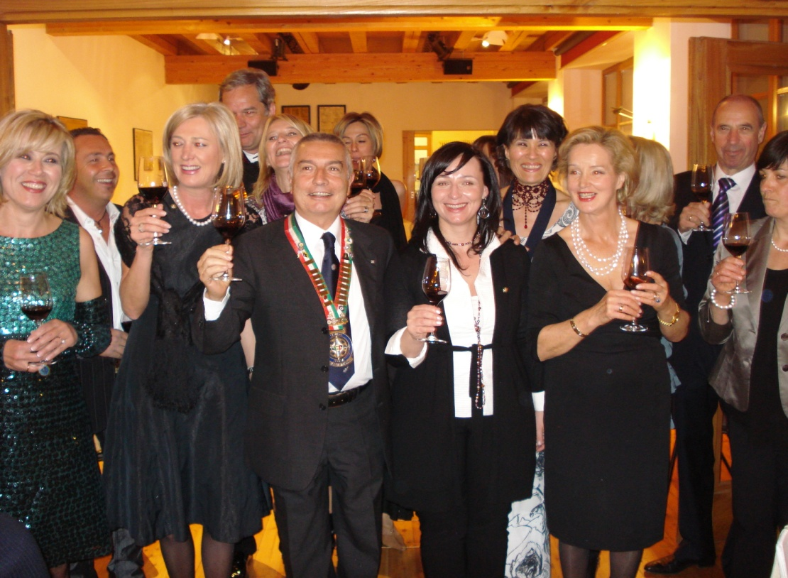
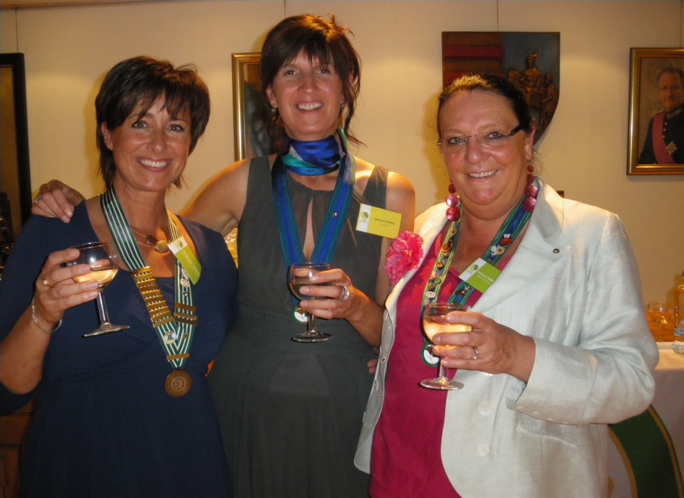
Charter Tongeren (B) 6-3-2010
Charter Merano (It) 9-4-2010
Charter Genk (B) 29-5--2010

Slide 13
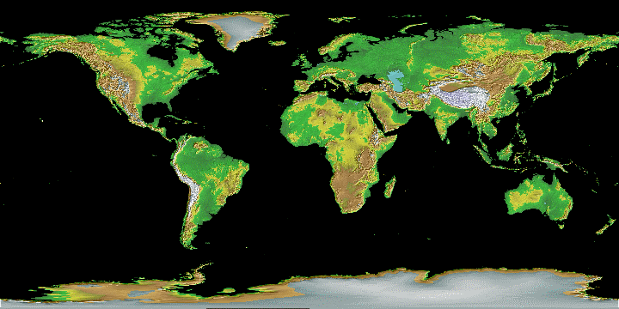
Not only local clubs are chartered……
Also internationally Agora Club
conquers the world !

Slide 14
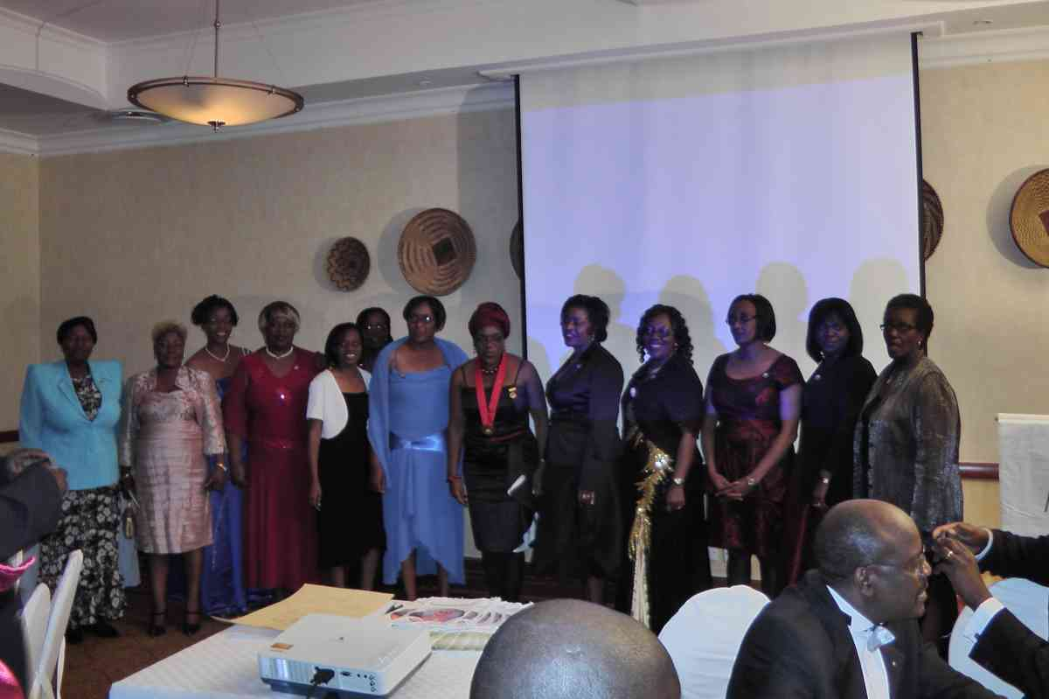
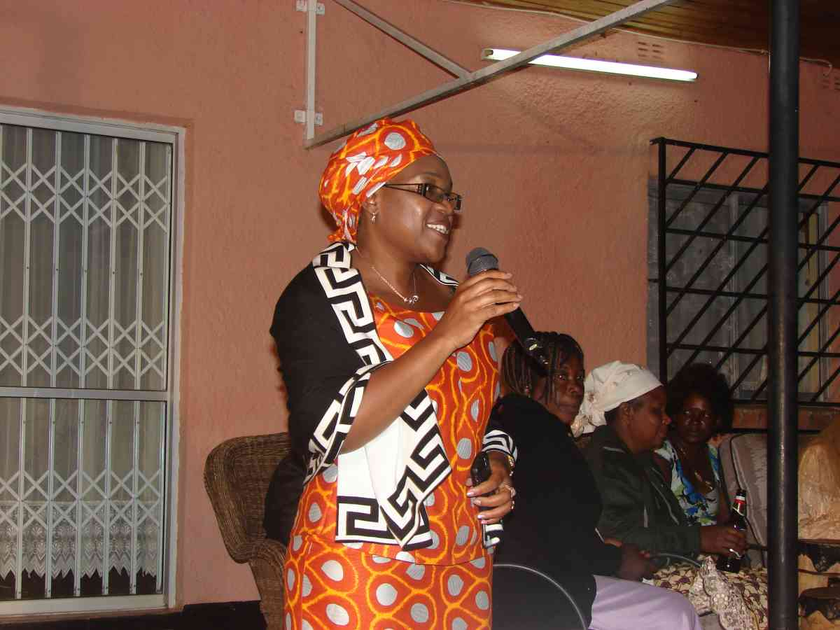
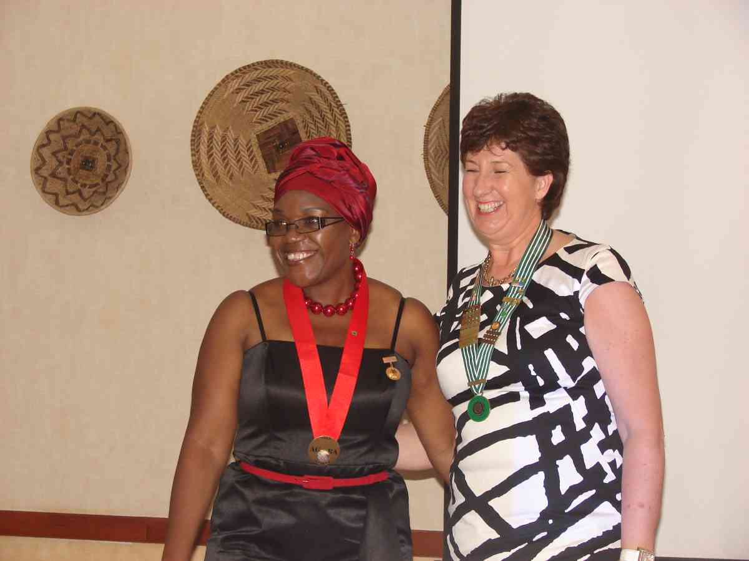
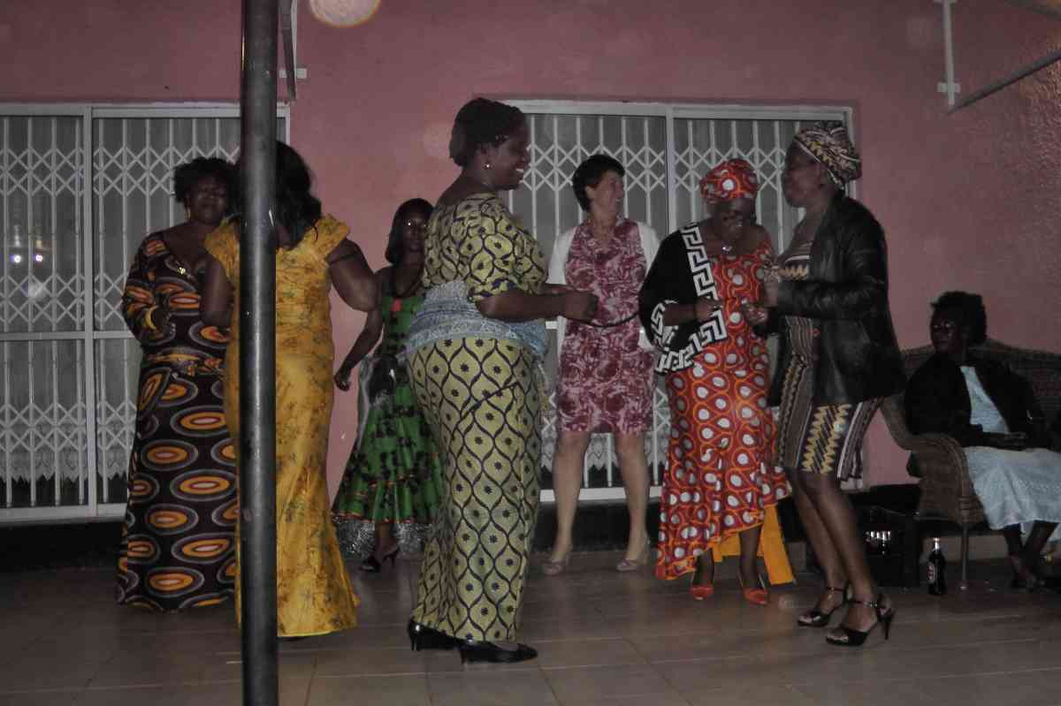
CHARTER AC ZAMBIA : 20-5-2010
Come on Danielle!
Shake those hips!

Slide 15
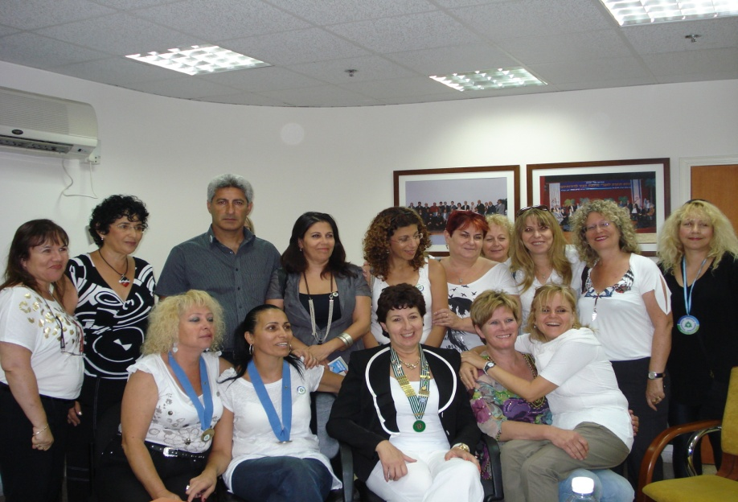
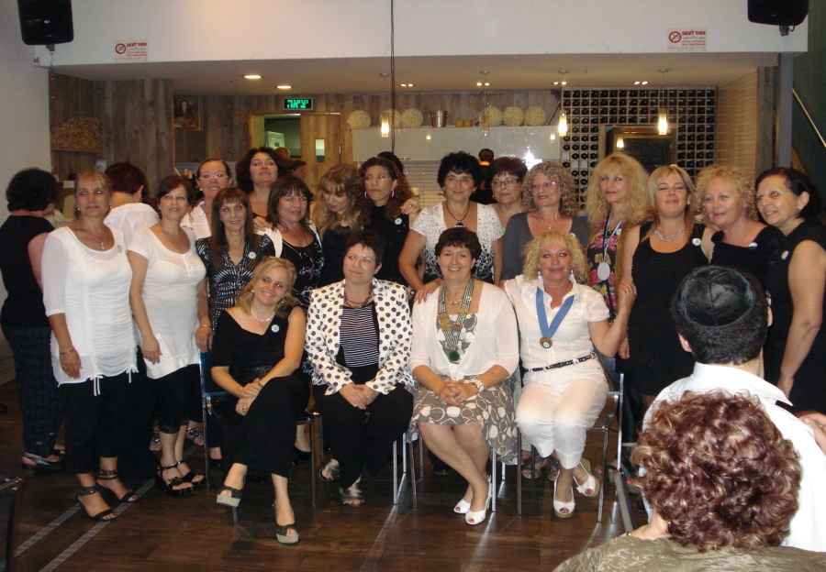
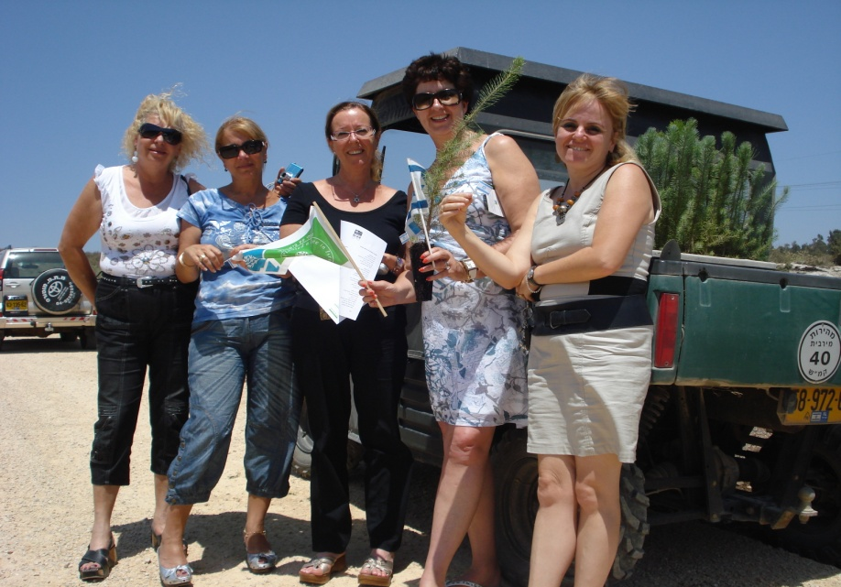
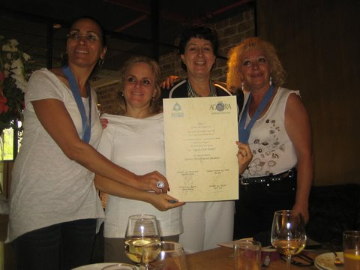
CHARTER AC ISRAEL : 19+20 June 2010
CHARTER AC 1 Merkaz
CHARTER AC 2 Krayot
Israel’s National “Plant- a -Tree – day”-
Installation National Board AC Israel

Slide 16
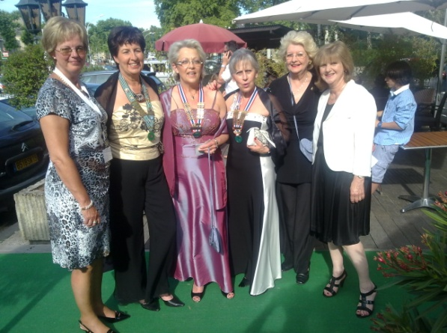
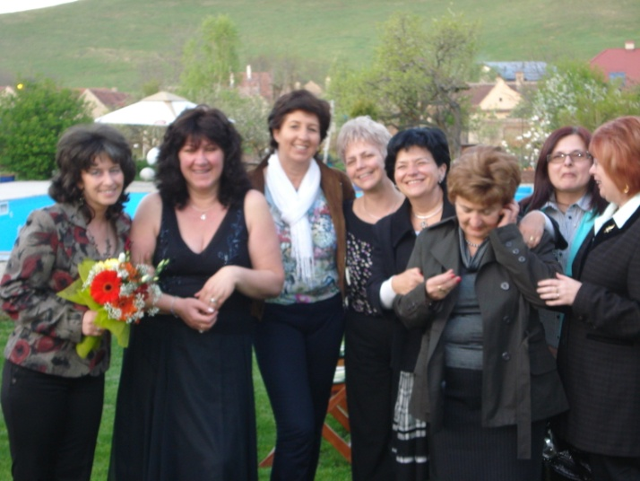
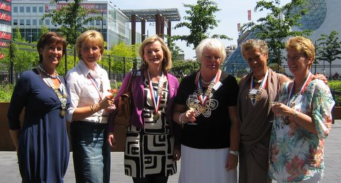
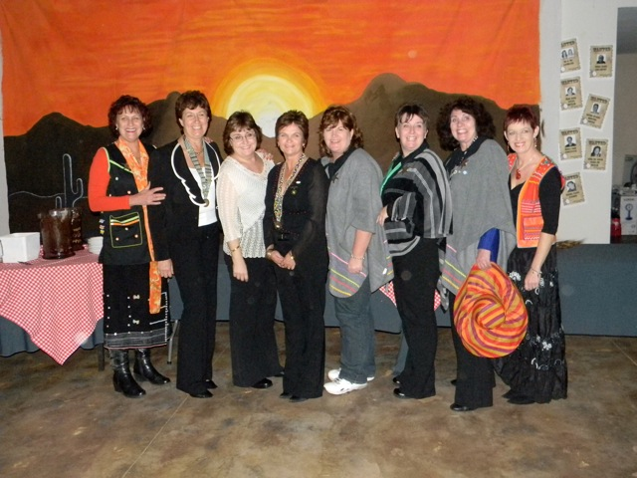
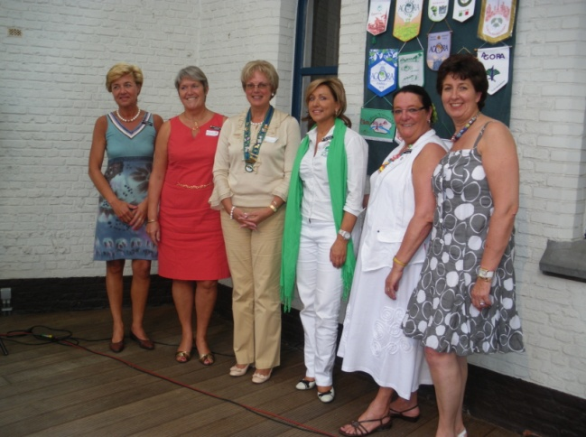
The ACI boarmembers were present at most National AGM’s
Daniëlle at AC Romania’s AGM 1-5-2010
Daniëlle and Dominique at
AC France’s AGM
5-6-2010
Veerle at
AC The Netherland’s AGM
5-6-2010
Daniëlle and Veerle at
AC Belgium’s AGM
26-6-2010
Nikkie and Danielle at
AC South Africa’s AGM 29-5-2010

Slide 17
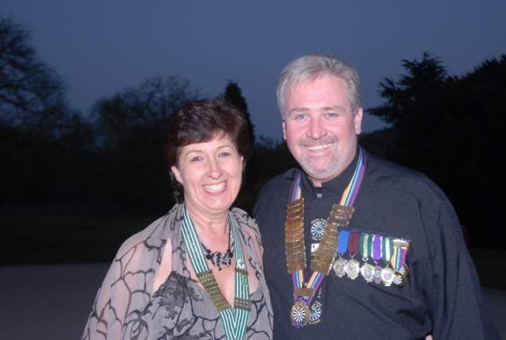
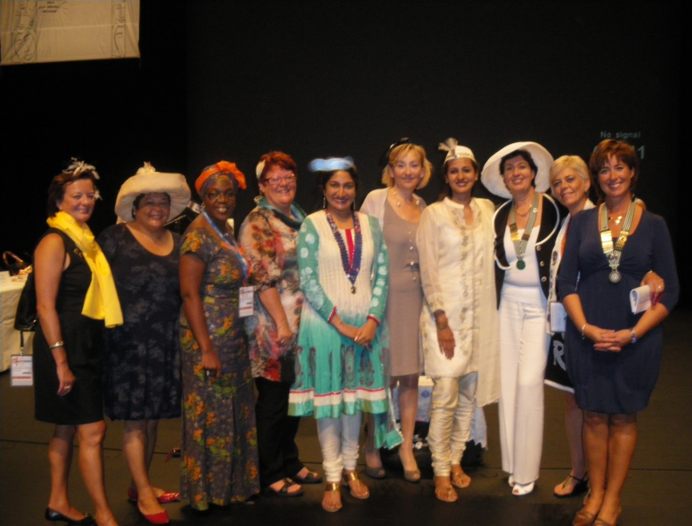
And even international 4 Clubs 1 Vision events…
24-4-2010 : Daniëlle with RTI President
Rikus Badenhorst at the
60th Anniversary of RT Belgium
27-8-2010 : Daniëlle and Veerle at the Ladies’ Circle International AGM in Bruges – Belgium

Slide 18
And off course we reported on all these events in our
NEWSLETTERS

Slide 19
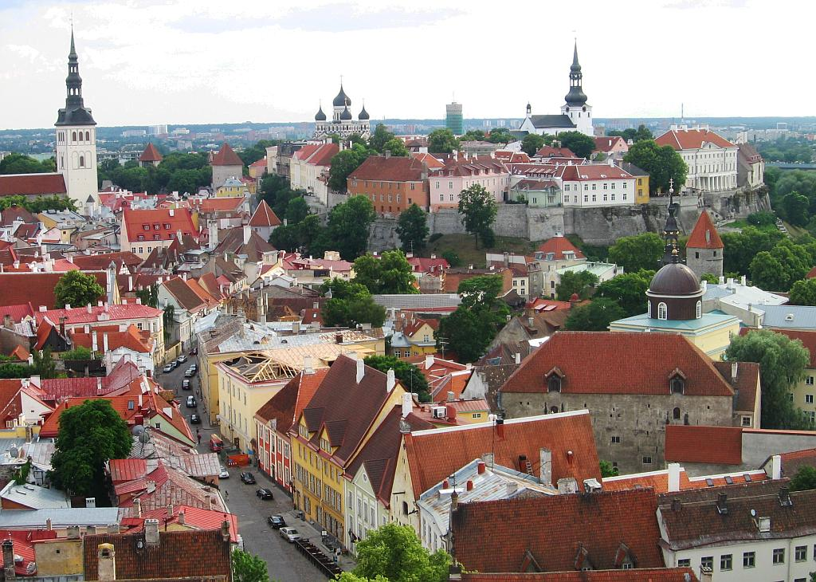
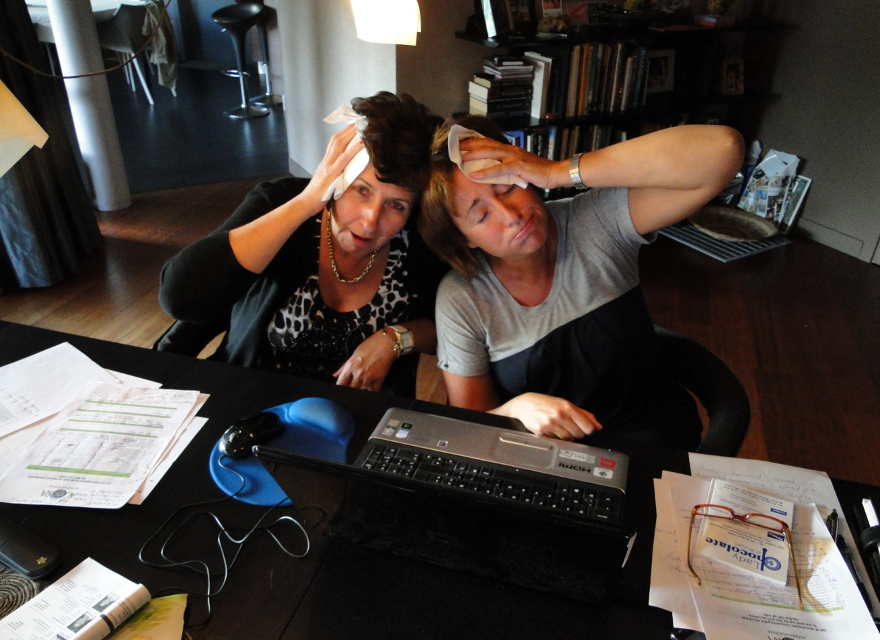
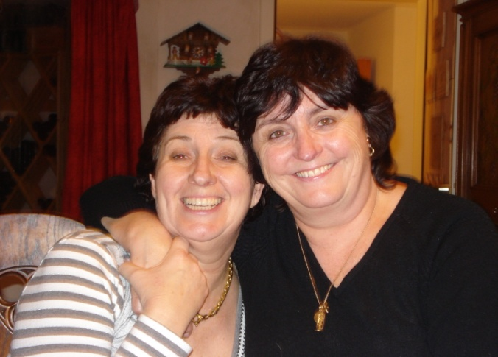
In South Africa at the time of the AGM on the 28th of May 2010, with Nikkie and Daniëlle
And then it was time to prepare for TALINN !
On 2 “split” boardmeetings
Veerle and Daniëlle hard at work on july 27th and August 15th 2010 !

Slide 20
And now for some really GREAT news!
Again, 2 new countries are ready to join us!
AC USA
AC POLAND
WELCOME
TO AGORA
GIRLS !!

Slide 21
It is clear to the ACI Board…
It is clear to the National Agora Boards…
It is clear to the Local Agora Boards…
It is clear to the 4 Clubs 1 Vision Boards…
WE
AGORA
FOR IT!
Power point presentation by Veerle De Jonge – ACI secretary 2009-2010

